Slide 1
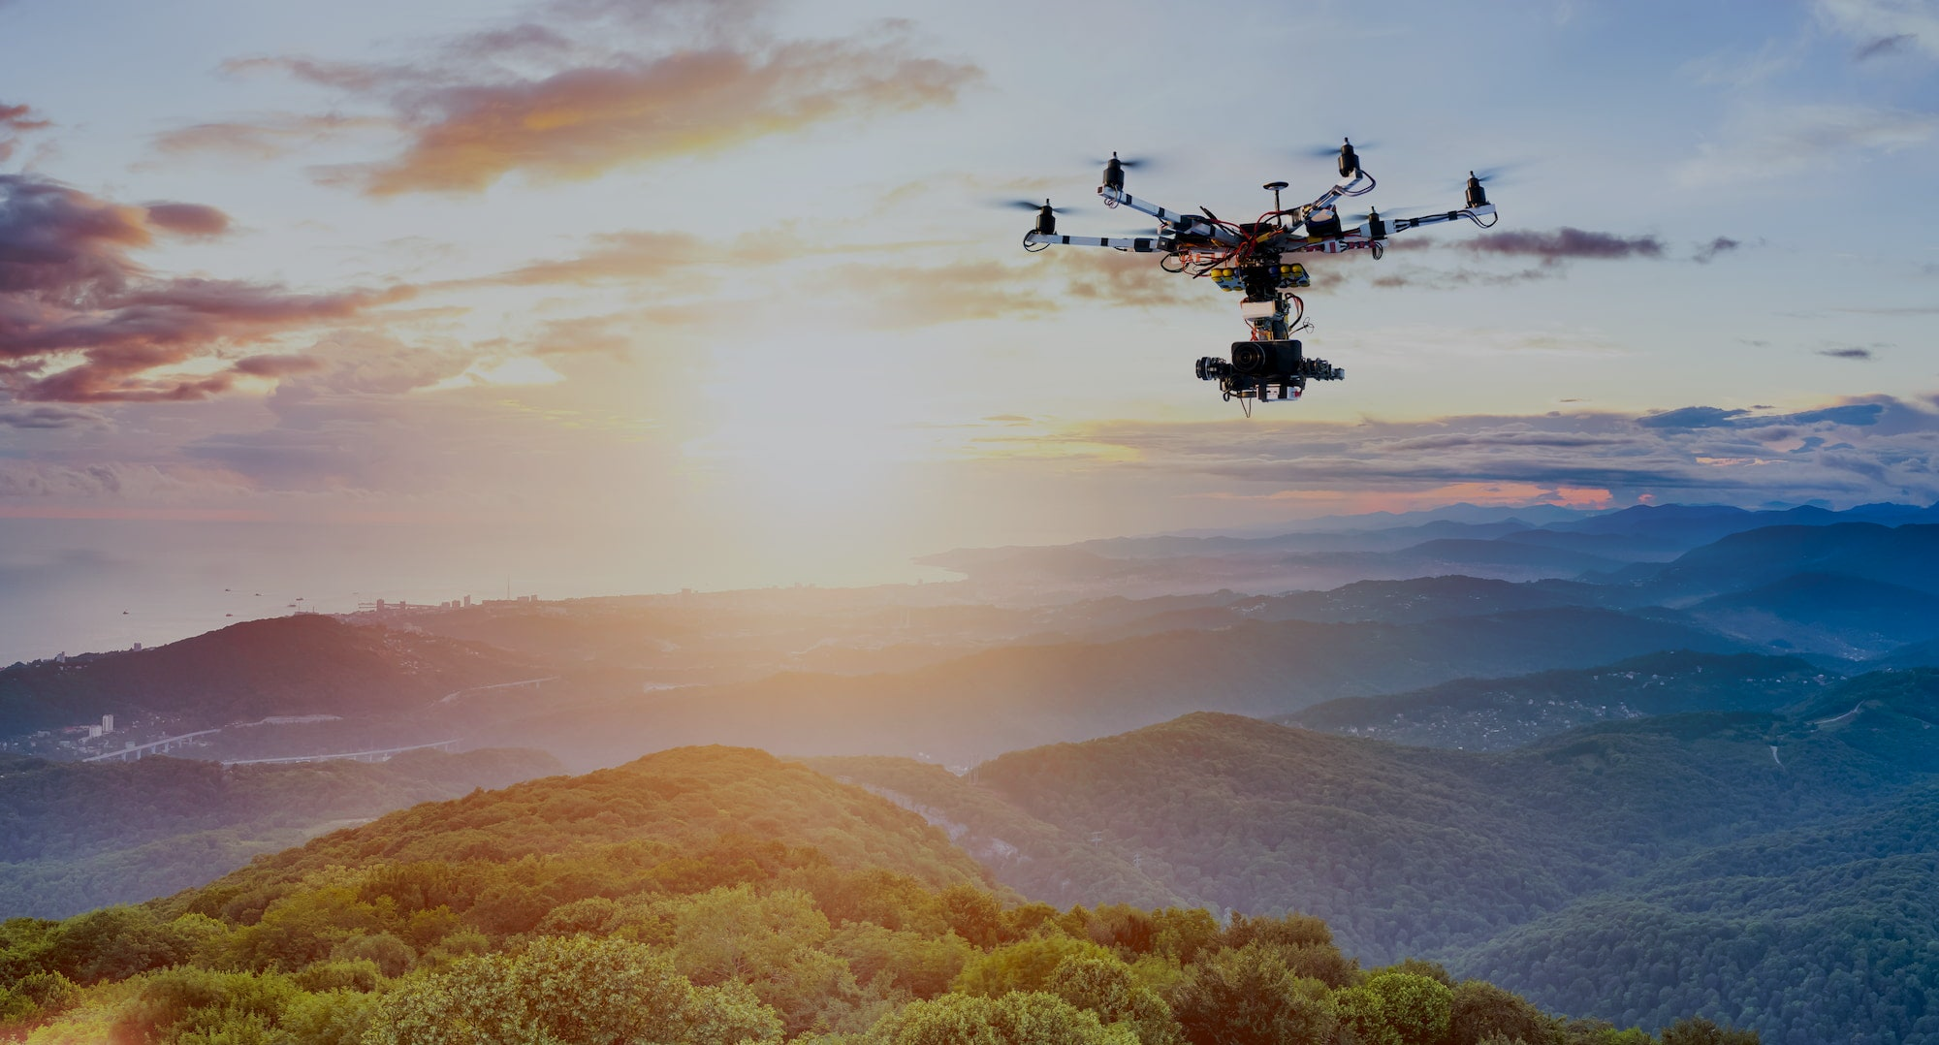

Automating for a greener tomorrow

Slide 2

Problem
Challenges of Current Forest Monitoring Methods:
Inadequate coverage
Delayed detection
Limited precision
Resource intensive
Costly and inefficient
Accessibility and terrain challenges
Limited night-time surveillance
Reactive approach

Slide 3
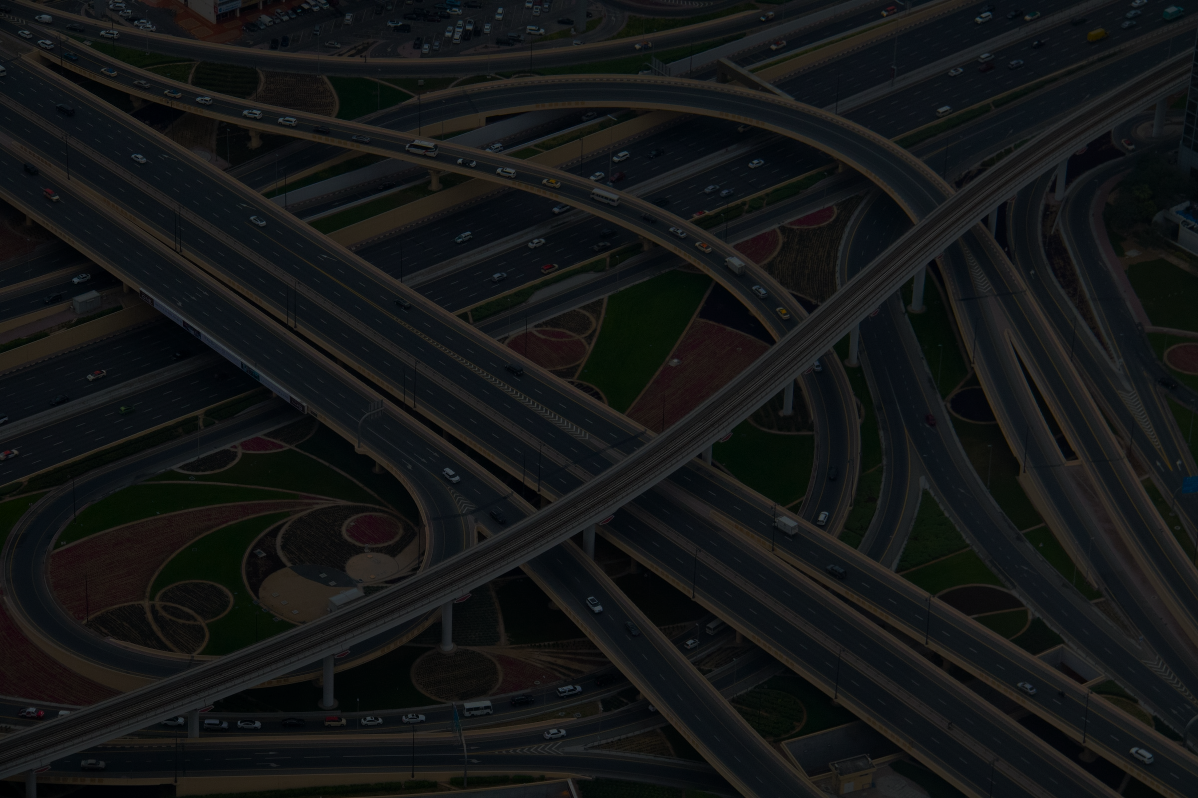
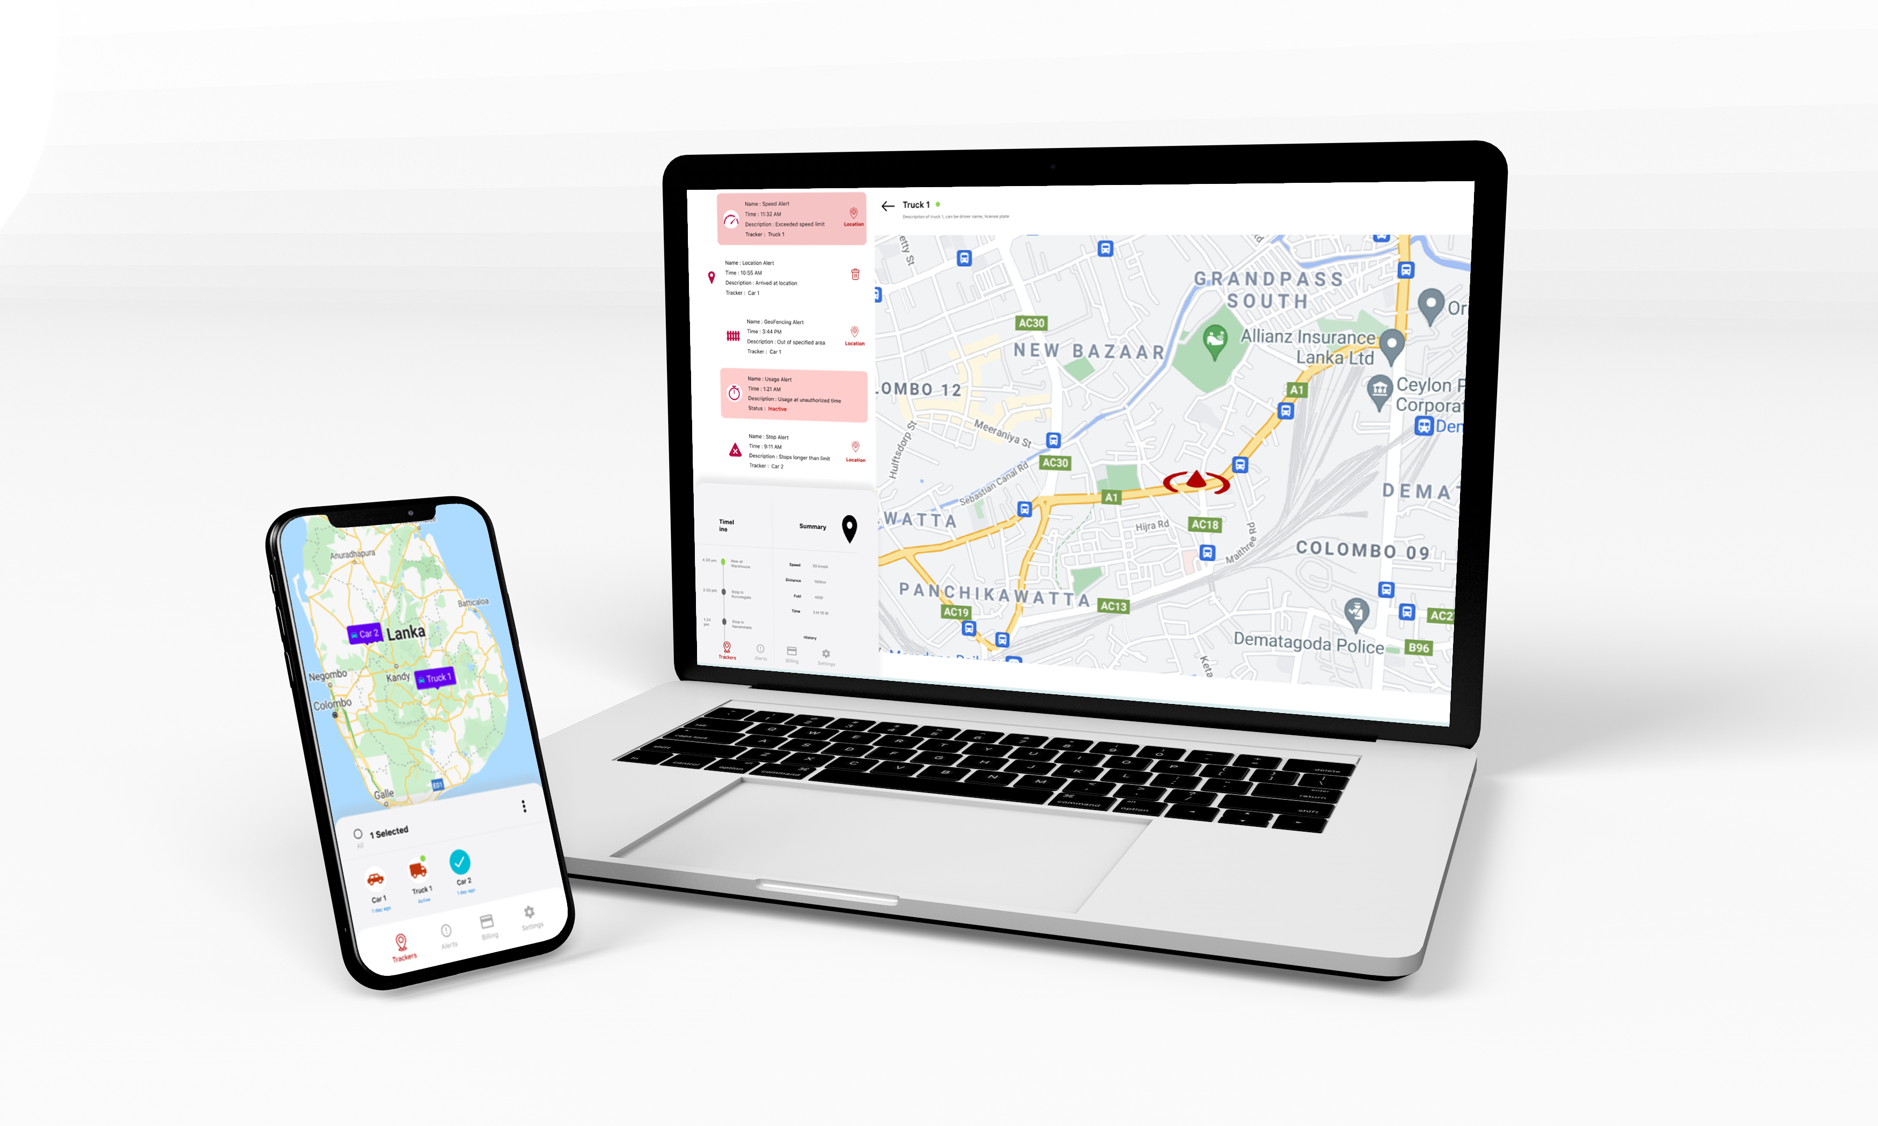




Solution
A centralized forest monitoring system including drones, mobile apps, and warning alarms for forest protection authorities.
Mobile and Web apps
Damage analysis & reports
Emergency Alerts
Fire and Logging monitoring
Notes:
Our solution is centralized platform for tracking all your business assets. We devised an innovative method to ensure the connection between you and your assets.

Slide 4
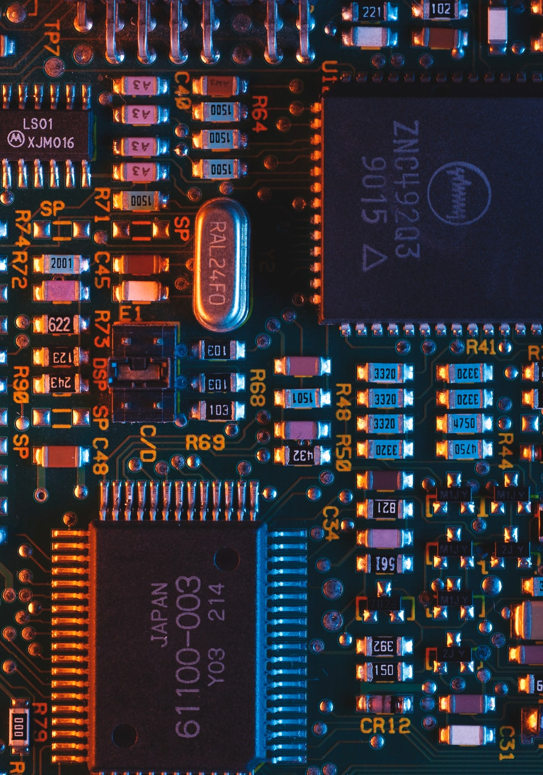
TECHNICAL INFORMATION highlighting viability and cost effectiveness

Slide 5
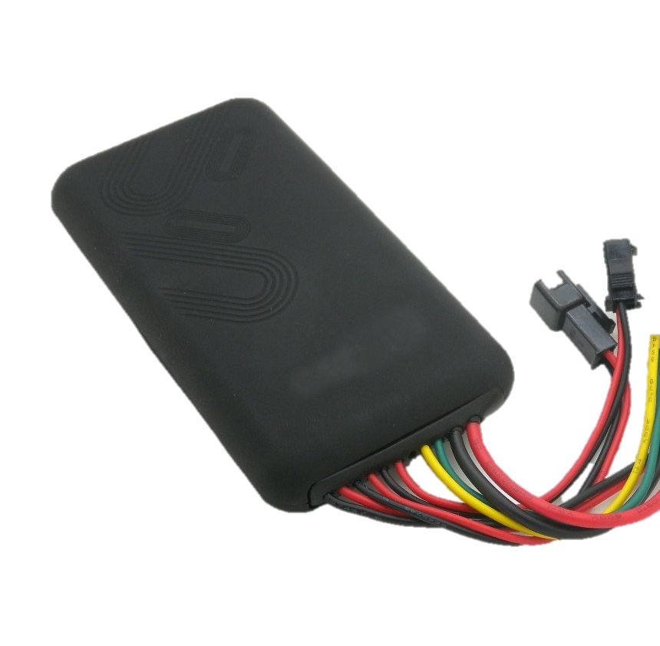
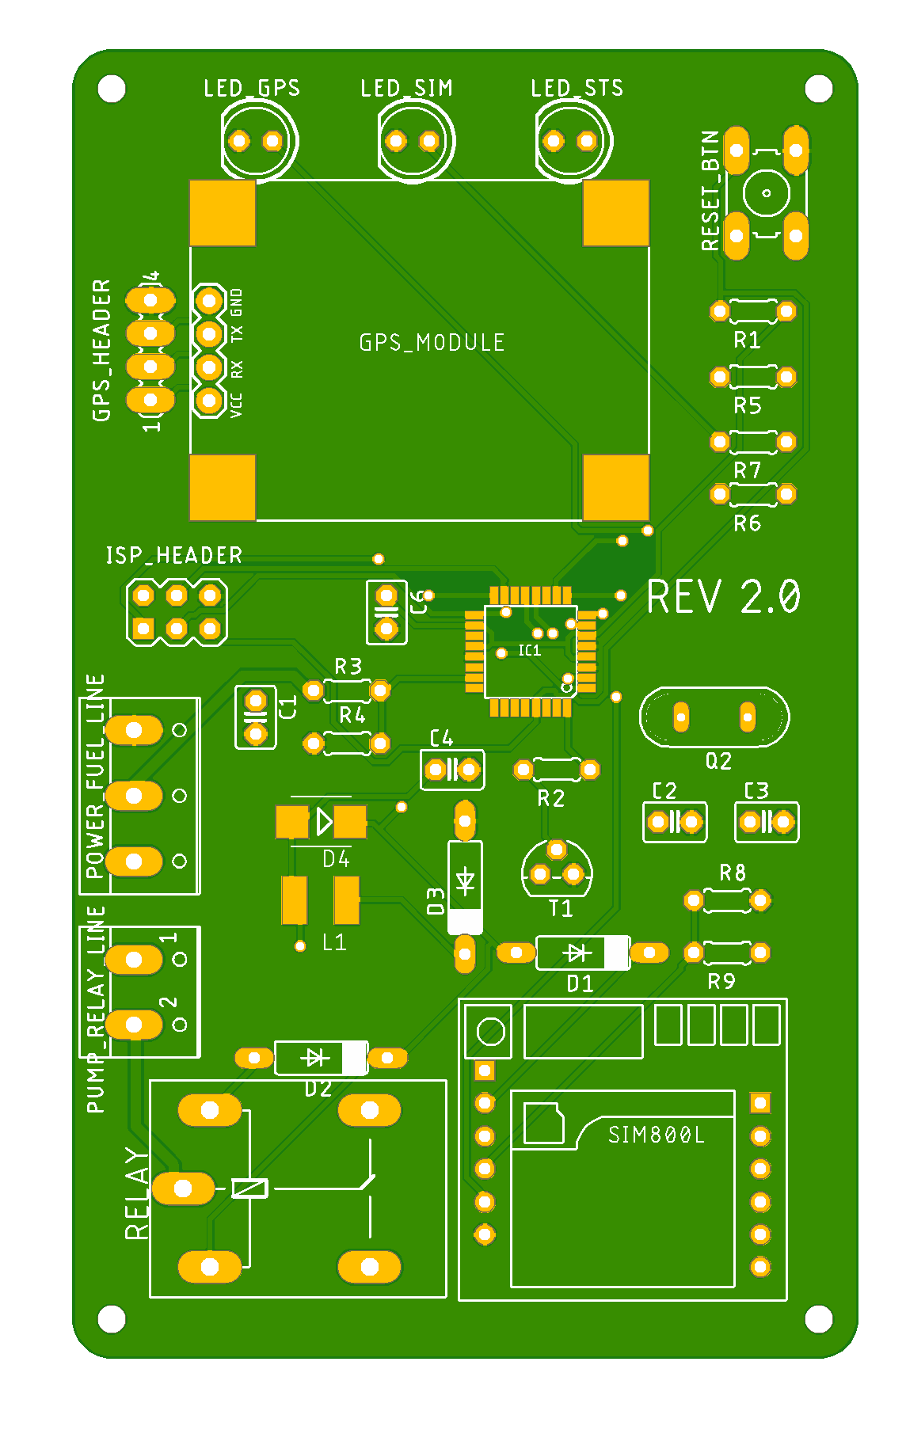
Hardware
Product
8 cm
Hardware components:
Processor
GPS Receiver
SIM Module
Camera
Waterproof hard plastic case
Fits on off-the-shelf drones
16 cm
2 cm
Designed PCB
Prototype

Slide 6
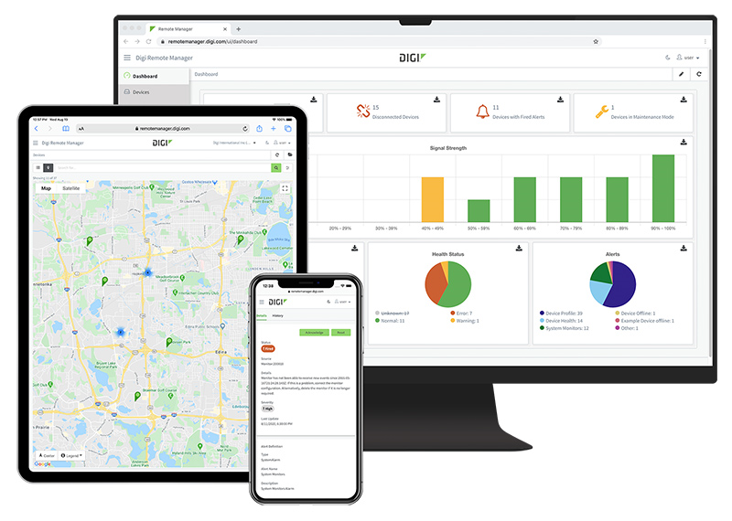





Software
Product
State-of-the-art Development Tools
Android, iOS Apps
React Native
Database
Firebase
Maps Provider
Google Maps
Cloud Functions

Slide 7
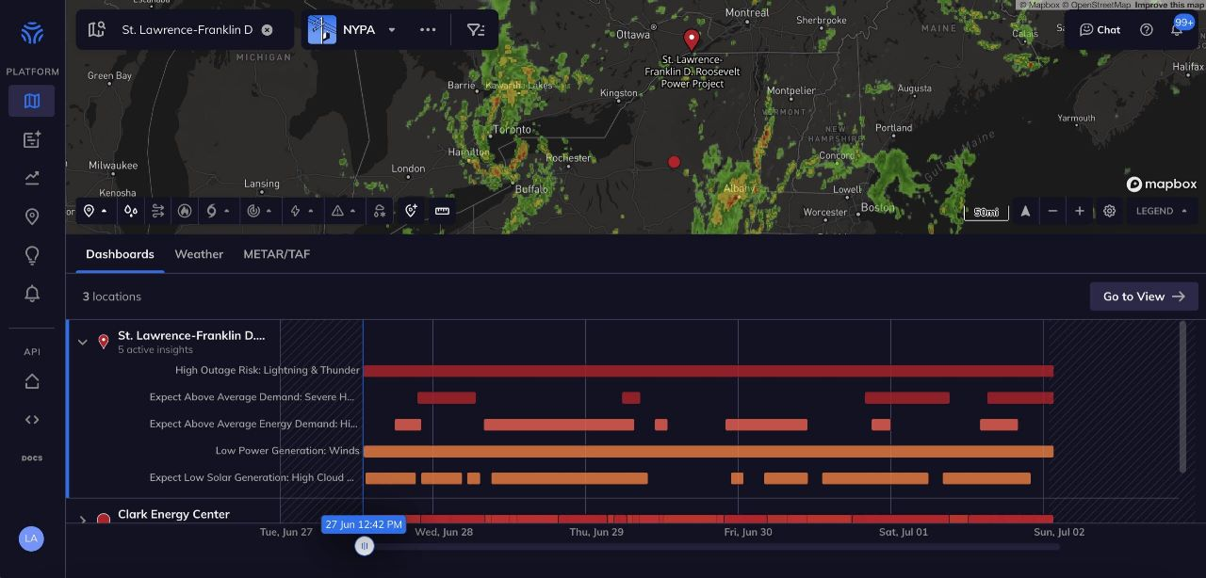

Slide 8






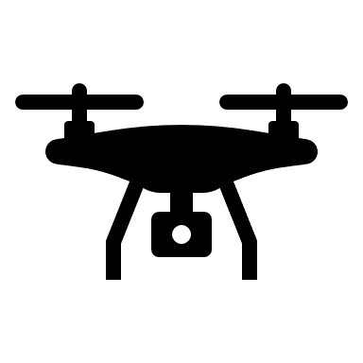
Process
Store & Analyze in cloud
Upload data
Inter drone communication
Access from PCs and mobile devices

Slide 9



Team
Thanushanth Kanagarajah
Supun Gamlath
Chathura Gunasekara
Notes:
It’s time to meet our team before we move on to questions

Slide 10


Thank You
Notes:
Thank you, we’ll be glad to answer any questions you have

